Slide 1

RememberThis
By Whisper4Lokal

Slide 2

Our Background

Slide 3

Software Developer
Data Scientist
Masters M2 in AI & Robotics
https://daveappadoo.com/
Scan QR to visit my blog for more details

Slide 4

Our problem statement

Slide 5

Note taking is amazing. However, sometimes we don’t have a pen and paper at hand.
Ideas and inspiration can occur unexpectedly
How do we store and remember these?
No pen and paper
Memorise the idea?

Slide 6

How my product can solve the problem and how it works

Slide 7

The solution
Our phones are always at hand.
Our app can record voice notes
The voice notes are:
Transcribed
Stored
Categorised automatically
Ideas and inspirations are stored!
And they can be searched!

Slide 8

The solution: AI

Slide 9

OpenAI Whisper made the magic happened.
Whisper for speech to text transcription
Keyword extractor to categorise texts
Google Sheets API for storing the texts and keywords

Slide 10
How we made it

Slide 11
Frameworks/Libraries used:
OpenAI Whisper
Gradio
pygsheets
pandas
Keybert

Slide 12

Demo

Slide 13
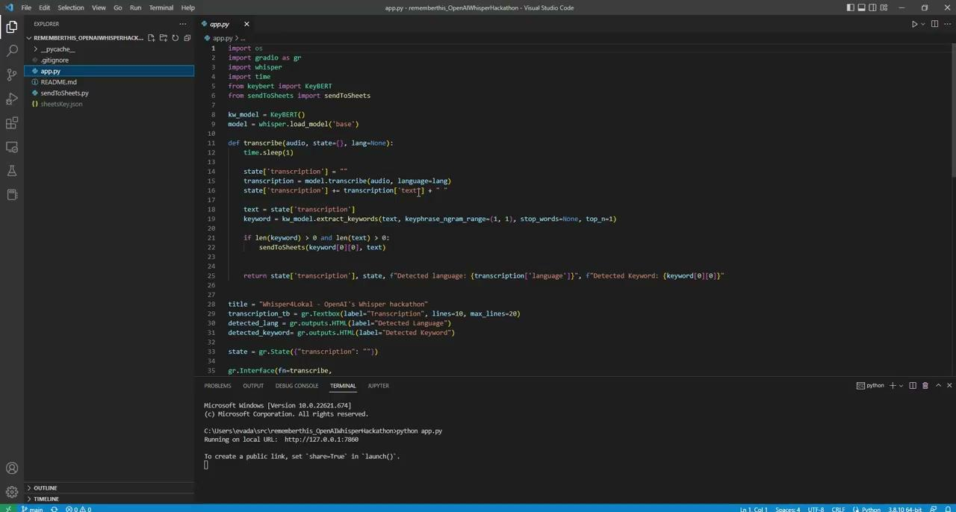

Slide 14
Thanks!

